Slide 1

Person-Centered Planning in Inclusive Postsecondary Education
Kathryn bURKE, PHD
pIHEC Annual symposium
July 30, 2024

Slide 2
Agenda
wARM-UP: “GOOD LIFE”
Person-centered planning: background and inclusive postsecondary education
Charting the lifecourse
WRAP-UP: APPLICATION

Slide 3

WARM-UP: “GOOD LIFE”

Slide 4
Turn and Talk: Imagine your “good life”.
What do you do everyday in your “good life”?
    Consider: What are you passionate about? What are your strengths?
Who do you spend time with in your “good life”?
    Consider: What relationships are most important to you?
What does support look like for you in your “good life”?
    Does support come from people? Organizations? Devices? Other resources in the environment?

Slide 5

PERSON-CENTERED PLANNING: BACKGROUND AND INCLUSIVE POSTSECONDARY EDUCATION

Slide 6
Person-Centered Planning: Concept
“A process that allows the person with a disability, family members, and friends an opportunity to share information regarding the individual to develop a personal profile and a future vision for the person” (Wells & Sheehey, 2012)
Centers the strengths, goals, and preferences of the person, while considering the person’s support needs across settings (Abery et al., 2022)
Food for thought: Do person-centered approaches and rights-based approaches always align? See Glicksman et al. (2017).

Slide 7
Person-Centered Planning: Research
People with disabilities more often report that their supports facilitate their “good life” when person-centered planning elements are incorporated into services (İsvan et al., 2023)
Research suggests positive but moderate impact on personal outcomes, with the need for additional work (Claes et al., 2010)

Slide 8

Person-Centered Planning: Inclusive Postsecondary Education (IPSE)
Person-centered planning can bridge the gap between supports identified through the individualized education program (IEP) process and the adult service system

Slide 9
Person-Centered Planning: IPSE (continued)
Researchers have explored specific tools to support students in IPSE to participate in person-centered planning, like the Self-Directed Summary of Performance (Mazzotti et al., 2015)
Other tools, like Charting the LifeCourse (Gotto et al., 2019), MAPS, and PATH (O’Brien & Pearpoint, 2007) may be widely used, although largely unexamined within research

Slide 10
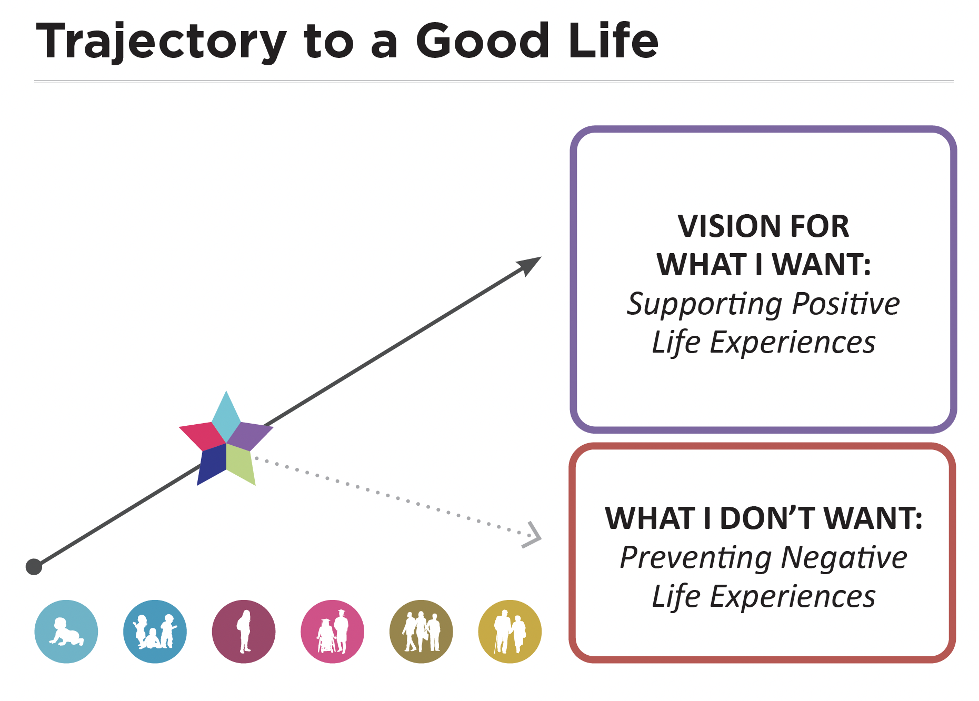
CHARTING THE LIFECOURSE
Charting the LifeCourse Framework, 2020

Slide 11
What is Charting the LifeCourse?
Model for person-centered planning developed at the University of Missouri, Kansas City
Includes fully developed suite of tools, including integrated supports star, one-page profile, and life trajectory
Ambassador training available (for cost); digital materials, including ready-to-use materials and video examples and guides available (free of charge)

Slide 12
How does Leadership & Career Studies at Temple University use Charting the LifeCourse?
Program staff are trained as ambassadors
Custom semi-structured interview protocol for initial planning session
One-page profile is updated with student each semester
Student is encouraged to share their one-page profile with their peer mentors, professors, and anyone else who collaborates with them on supports

Slide 13
Person-Centered Planning Initial Session: Preparation
As was discussed during the admissions process, we conduct Person-Centered Planning sessions prior to students beginning their first semester with Leadership & Career Studies.
This session is a program requirement and will last approximately two hours. We invite you, family members, and any other close friends or support providers who know you well and who you feel would be important to the process to attend. We want to be mindful of the number of people in the session to ensure you are comfortable expressing yourself freely, so we ask you to invite no more than 3 to 4 people.

Slide 14

Person-Centered Planning Initial Session: Semi-Structured Interview
Introductions and Expectations
Integrated Supports Star
Path (Trajectory) and Vision
One-Page Profile
Wrap-Up

Slide 15
Introductions and Expectations
Let’s set some ground rules before we start talking–
  We have 2 hours to dedicate to meaningful, thoughtful conversation with Ja’nae about their educational/work goals. We thank you so much for dedicating your time to this process. In turn, we’ll respect your time and wrap this up within two hours. If you need breaks, feel free to stand up and walk around, etc.
  We welcome everyone to have open conversation and bring creative thinking, BUT at the end of the day, Ja’nae is the focus and we want THEIR priorities and THEIR voice to come through above all others.

Slide 16
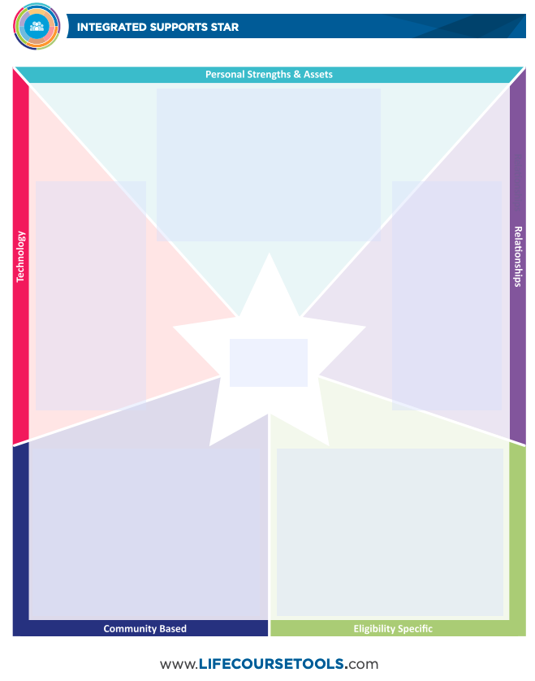
Integrated Supports Star
The blue part at the top is personal strengths and assets. These are skills like personal abilities, knowledge, or life experiences. They are strengths such as things you’re good at or others like and admire, and they are assets like personal belongings or resources.
What do you like most about yourself?
What are your best qualities and strengths?
Do you have any special talents?
How would others describe you? What do others really like/love about you? Ask others in the room.
What keeps you motivated to keep working or doing something?
Charting the LifeCourse Framework, 2020

Slide 17
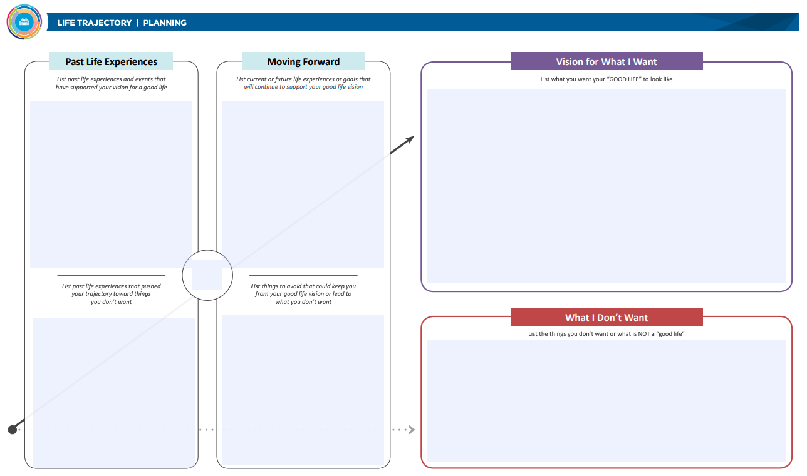
Path (Trajectory) and Vision
Charting the LifeCourse Framework, 2020

Slide 18
Path (Trajectory) and Vision
Now let’s talk about your vision for your Temple experience. We will do this by talking about past life experiences and future experiences or goals. The path (another word for trajectory) shows the vision for what you want as a Temple student and also what you do not want.
Interests
What kinds of activities were you involved with in high school?
What do you love the most? What interests you the most?
What kinds of fun things do you do in the community? How often?
What kinds of physical activity/exercise do you like, if any? How often do you do these?
How do you find out about events and activities that you want to go to?
Is there anything you would like to do or explore on campus that you do not do right now?

Slide 19
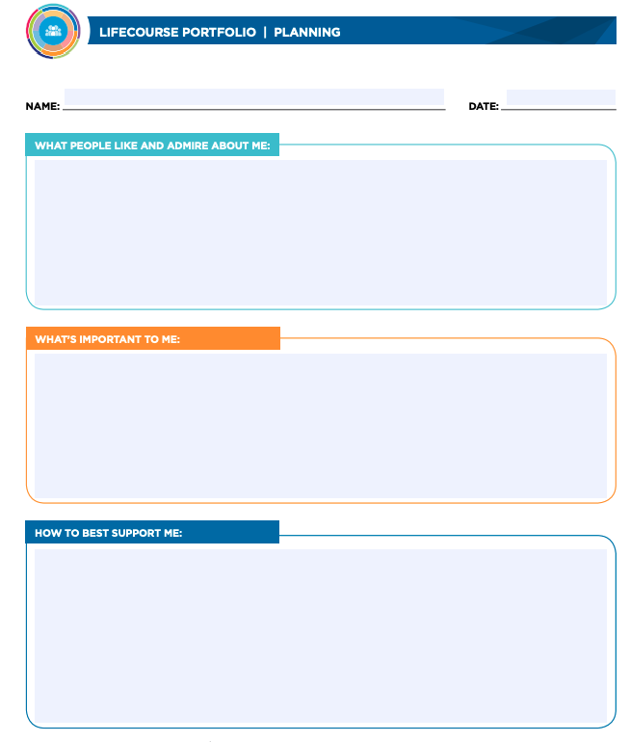
One-Page Profile
Now that you have talked about your integrated supports star, path/trajectory, and vision, let’s create this one-page profile. A one-page profile shows the important information you shared today. This can be helpful for peer mentors and others getting to know you and providing support. We will use what you shared already to complete this.
What do people like and admire about you?
Can prompt to look at the personal strengths & assets section in integrated supports star.
Charting the LifeCourse Framework, 2020

Slide 20
Wrap-Up
Let’s review the materials to make sure they accurately reflect you and your vision for a good life. Review. Is there anything we should change?
Once we finalize these materials, we will share a copy with you. Your advisor will work with you to update the one-page profile at the beginning of each semester. Thank you for sharing with us today, and thank you to the important people in your life who joined. We look forward to a great four years with you at Temple!

Slide 21

WRAP-UP: APPLICATION

Slide 22
Turn and Talk (New Partner!): Apply Charting the LifeCourse
What would this model look like in your setting?
    Consider: What would students and families share?
What might you change about the model?
    Consider: What was missing from the examples? What is unique (special) about your setting?
How can you get started?
    Consider: What’s your first step? Who can support you?

Slide 23
References
Abery, B., Tichá, R., Šiška, J., & Stancliffe, R.J. (2022). Modernizing transition: A social-ecological approach. Impact, 35.
Claes, C., Van Hove, G., Vandevelde, S., van Loon, J., & Schalock, R. L. (2010). Person-centered planning: Analysis of research and effectiveness. Intellectual and Developmental Disabilities, 48(6), 432–453.
Glicksman, S., Goldberg, C., Hamel, C., Shore, R., Wein, A., Wood, D., & Zummo, J. (2017). Rights-based and person-centered approaches to supporting people with intellectual disability: A dialectical model. Intellectual and Developmental Disabilities, 55(3), 181–191.
Gotto, G. S., Reynolds, M. C., Palmer, S. B., & Chiang, D. F. (2019). Supporting families through the Charting the LifeCourse framework. Intellectual and Developmental Disabilities, 57(1), 56–65.
İsvan, N., Bonardi, A., & Hiersteiner, D. (2023). Effects of person-centred planning and practices on the health and well-being of adults with intellectual and developmental disabilities: A multilevel analysis of linked administrative and survey data. Journal of Intellectual Disability Research, 67(12), 1249–1269.
LifeCourse Nexus. (2024). Charting the LifeCourse Framework and Tools. University of Missouri, Kansas City. www.lifecoursetools.com
Mazzotti, V., Kelley, K., & Coco,C. (2015). Effects of self-directed summary of performance on postsecondary education students’ participation in person-centered planning meetings. The Journal of Special Education, 48(4) 243–255.
O’Brien, J., & Pearpoint, J. (2007). Person-centered planning with MAPS and PATH: A workbook for facilitators (5th ed.). Inclusion Press.
Wells, J. C., & Sheehey, P. H. (2012). Person-centered planning: Strategies to encourage participation and facilitate communication. TEACHING Exceptional Children, 4(3), 32-39.

Slide 24

Thank you!
Contact:
kburke@temple.edu
iod@temple.edu

